Slide 1
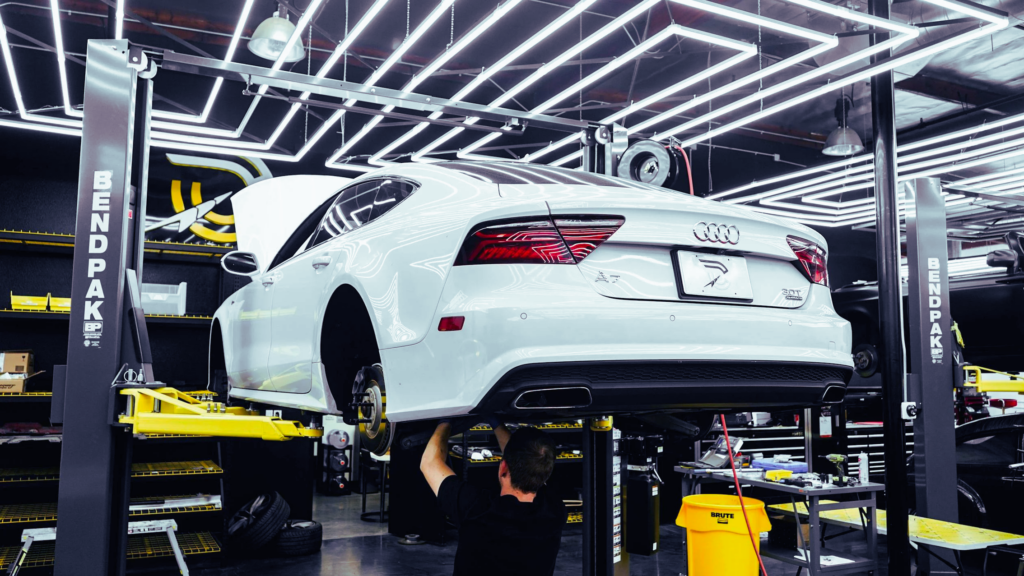
DEMPSEY AND DELTA LOGISTICS
Our Business Strategy for 2025
Enhancing the Automotive Supply Chain in Response to Semiconductor Shortages
Team 14

Slide 2
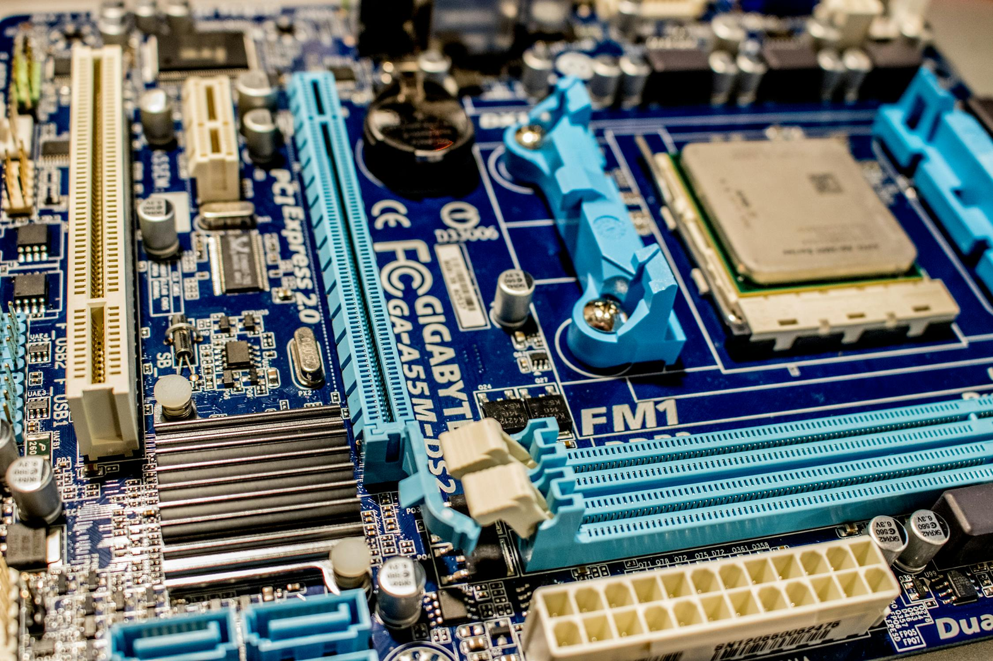



Introduction
The semiconductor shortage crisis started in 2021, caused by the pandemic and its impact on global supply chains.
The automotive industry was directly affected by this since chips are a crucial element in vehicles.
Production delays
Revenue loss
Rising prices
The crisis shed a light on the importance of supply chain transformation and the necessity of digitalization and collaboration between moving parts.
Notes:
The semiconductor shortage crisis started around 2021, and it was caused by a variety of causes. One primary cause was the pandemic, which led to other effects that built on the crisis. The pandemic caused large disruptions in supply chains all over the world, shutting down factories and making logistics almost impossible. As a consequence of the pandemic, most of the world was found in lockdown, leading to a large increase in demand for electronics, which started consuming a lot of the semiconductor supply that was available at the time. Global supply chain weaknesses were exposed by this crisis, especially within the semiconductor supply chain, which consists of a lot of different moving parts and is collaborative between suppliers that only focus on producing and completing certain parts.
The crisis directly affected the automotive industry, that relies on chips to complete the manufacturation of vehicles. Chips are a crucial element for a car to run. Car manufacturers consequently had to delay or stop production. The industry faces immense economic losses that came up to over 200 billion dollars. Also, with a very limited supply and a growing demand, car prices increased heavily.
The crisis shed a light on the importance of supply chain transformation and the necessity of digitalization and collaboration between moving parts.
(Roy et al., 2024)

Slide 3




Background
SEMICONDUCTORS
SHORTAGE
SUPPLY CHAIN
VISIBILITY
DIGITAL
TRANSFORMATION
ADVANCED
TECHNOLOGIES
Notes:
Background
In recent years, the automobile industry has faced significant semiconductor shortages. This issue arose primarily due to the increased demand for technological supplies like laptops and cell phones during the pandemic, along with disruptions in the supply chain caused by factory shutdowns. Geopolitical issues with Taiwan, a major player in semiconductor manufacturing, further exacerbated the problem (Burkacky et al., 2022).
Moreover, many automotive companies rely on just-in-time inventory practices but lack a transparent supply chain. The absence of real-time tracking has made it difficult to anticipate and mitigate such issues. The complexity of the supply chain, involving numerous manufacturers with different tracking programs, adds to the challenge of accessing real-time data (MIT Technology Review, 2022).
To improve the supply chain, the automotive industry needs to embrace digital transformation. This would enhance visibility and predictability. Implementing advanced technologies, such as blockchain, used in other sectors, can be crucial in achieving this transformation (Lawler, 2023).

Slide 4




Current Supply Chain Situation
Automotive Semi-conductor Demand Forecasting Challenges
Just-In-Time Supply Chain Visibility Gaps
Automotive Chip Supply Lead Times
Competition From Consumer Electronics
Unclear technology roadmaps for predicting chip needs in new vehicle models
Complexity from frequent changes to custom vehicle orders mid-production
Limited visibility into semiconductor content across vehicle components/features
Lack of end-to-end supply chain transparency on chip usage and inventory
No standardized data sharing between automakers, suppliers, and chipmakers
Minimal advanced analytics for semiconductor supply/demand monitoring
4-month minimum lead time if manufacturing capacity available
18+ months if capacity expansion required for automotive-grade chips
3+ years to build new semiconductor fabrication plants for automakers
Automotive lower priority as chip demand spiked for PCs, cellphones during pandemic
Mature node capacity constrained, fiercer competition for auto-grade chips
Cost-sensitive automotive semiconductors de-prioritized by suppliers
Notes:
(Burkacky, O., Deichmann, J., Pfingstag, P., & Werra, J. (2022). Semiconductor shortage: How the automotive industry can succeed. McKinsey & Company)
Current Automotive Supply Chain Situation Analysis
1. Automotive Semiconductor Demand Forecasting Challenges
The automotive industry faces significant challenges in forecasting semiconductor demand:
• Unclear Technology Roadmaps: Predicting the specific types of semiconductor chips needed for new vehicle models is challenging, complicating both planning and production.
• Complexity from Frequent Changes: Automakers frequently update their vehicle orders mid-production, necessitating adjustments in the semiconductor components required.
• Limited Visibility into Semiconductor Content: There is a lack of clear information regarding which semiconductor components are used in various vehicle features, making it difficult to optimize and streamline the supply chain.
2. Just-In-Time Supply Chain Visibility Gaps
The Just-In-Time (JIT) supply chain model in the automotive industry suffers from several visibility gaps:
• Lack of End-to-End Supply Chain Transparency: Insufficient visibility across the entire supply chain, from chip fabrication to vehicle assembly, hampers effective planning and disrupts response mechanisms.
• No Standardized Data Sharing: Different stakeholders, including automakers, suppliers, and chipmakers, lack a uniform approach to data sharing, leading to inefficiencies and miscommunications.
• Minimal Advanced Analytics for Semiconductor Supply/Demand Monitoring: The automotive industry lacks sophisticated analytical tools to accurately forecast and respond to fluctuations in semiconductor supply and demand.
3. Automotive Chip Supply Lead Times
The lead times for supplying automotive chips are considerable:
• 4-Month Minimum Lead Time if Manufacturing Capacity Available: Producing automotive-grade chips takes at least four months if manufacturing facilities are ready and available.
• 18+ Months if Capacity Expansion Required: Expanding production facilities to meet increased demand can take over a year and a half.
• 3+ Years to Build New Semiconductor Fabrication Plants for Automakers: Constructing new semiconductor fabrication plants specifically for automotive chip production is a long-term effort, taking several years.
4. Competition From Consumer Electronics
The automotive industry faces intense competition for semiconductor chips from the consumer electronics sector:
• Automotive Lower Priority for Chips: During the pandemic, consumer electronics such as PCs and smartphones were prioritized over automotive for chip allocation.
• Mature Node Capacity Constrained: Older semiconductor manufacturing processes ("mature nodes") are often at full capacity, leading to fierce competition among industries, including automotive.
• Cost-Sensitive Automotive: The automotive industry typically operates with tighter margins and is more cost-sensitive compared to consumer electronics, affecting the prioritization by chip suppliers.

Slide 5



Technology and their Applications
AI to detect changes in demand and supply
IoT solving Chip Shortage
Blockchain integration with IoT
Notes:
AI: AI tools, like Google Video AI, can detect real time demand changes and detect supply disruptions at different supply chain tiers like ports and warehouses (Sjs, 2024).
IoT: IoT can optimize route of semiconductor components and products and identify bottlenecks (Gdali, 2024).
Blockchain: BCT solves bullwhip effect problem by protecting data, improves supply chain traceability and visibility- providing complete audit trail (Magdy et al., 2023).

Slide 6




Qualitative Benefits of Digital Transformation
1.
ENHANCED DECISION MAKING
2.
PROACTIVE RISK MANAGEMENT
3.
BUILD RESILIENCY IN THE SUPPLY CHAIN
4.
ENHANCED COLLABORATION AND COMMUNICATION
Notes:
(EY, 2024)
1.Enhanced decision-making: Advanced analytics and machine learning enable strategic, data-driven decisions, improving forecasting, inventory optimization, and resource allocation.
2.Proactive risk management: AI-driven technologies can evaluate past data to forecast possible disruptions, like supplier delays or spikes in demand, enabling businesses to reduce risks before they become real. Supply chain managers can simulate and test different "what-if" scenarios and create strong backup plans with the help of digital tools.
3.Build resiliency in the supply chain: Traditional supply chains can't handle ongoing disruptions. Shifting from “just in time” to "just in case" means enhancing resiliency with end-to-end visibility, risk monitoring, alternative supplies, a resilient workforce, and better cybersecurity. Also, optimize logistics by fulfilling orders cost-effectively (EY, 2024).
4. Enhanced collaboration and communication: Digital transformation fosters seamless communication across the supply chain, integrating suppliers, manufacturers, and distributors on a single platform
5. Furthermore, instantaneous data exchange ensures all stakeholders are on the same page, reducing the likelihood of errors and improving overall coordination.

Slide 7

Measuring Digital Technology Effectiveness in Supply Chains
01
PERFECT
ORDER RATE
The percentage of orders delivered without any issues, such as delays, damages, or inaccuracies.
02
CYCLE TIME REDUCTION
The reduction in time taken to move a product from order to delivery, measured pre- and post-digital transformation.
03
DIGITAL TRACEABILITY INDEX
The extent to which a company can track and trace products throughout the supply chain using digital tools.
04
INVENTORY ACCURACY
The accuracy of inventory records compared to physical stock.
05
SUSTAINABILITY METRICS
Metrics such as carbon footprint reduction, waste minimization, and resource optimization, enabled by digital technologies.
Notes:
Key Performance Indicators (KPIs) in Supply Chain Performance
1. Perfect Order Rate
• Definition: The percentage of orders delivered without any issues such as delays, damages, or inaccuracies.
• Significance: Indicates the efficiency and reliability of the supply chain. A higher perfect order rate signifies better customer satisfaction and fewer disruptions.
2. Cycle Time Reduction
• Definition: The reduction in time taken to move a product from order to delivery, measured pre- and post-digital transformation.
• Significance: Highlights the impact of digital transformation on operational efficiency. Shorter cycle times can lead to faster deliveries, improved customer satisfaction, and better inventory management.
3. Digital Traceability Index
• Definition: The extent to which a company can track and trace products throughout the supply chain using digital tools.
• Significance: Enhances visibility and transparency within the supply chain. Higher traceability can improve risk management, compliance, and responsiveness to issues such as recalls or delays.
4. Inventory Accuracy
• Definition: The accuracy of inventory records compared to physical stock.
• Significance: Essential for effective inventory management. High inventory accuracy ensures optimal stock levels, reduces carrying costs, and minimizes stockouts or overstock situations.
5. Sustainability Metrics
• Definition: Metrics such as carbon footprint reduction, waste minimization, and resource optimization, enabled by digital technologies.
• Significance: Reflects the company's commitment to sustainability. Improved sustainability metrics can lead to cost savings, regulatory compliance, and enhanced corporate reputation.

Slide 8

Challenges
&
Solutions
01
HIGH INITIAL COSTS
Seek government grants and incentives for digital transformation initiatives to make the automotive industry more resilient and sustainable
02
INTEGRATION ISSUE
Define standards for integrating semiconductor data across supply chain
Alignment across procurement, supply chain, IT, product development
Establish governance for sharing semiconductor data across OEM
03
DATA SECURITY CONCERNS
Implement cybersecurity controls to protect sensitive chip information
Use a Multi-Layered Security Approach such as firewalls or intrusion detection systems
04
CHANGE MANAGEMENT
Create a technology roadmap that connects supply chain functions to better develop next-gen semiconductor innovations
Communicate the benefits of digital transformation clearly to all stakeholders
Notes:
1. Seek Government Grants and Incentives for Digital Transformation Initiatives
To make the automotive industry more resilient and sustainable, it is crucial to seek government grants and incentives. These financial aids can significantly offset the high initial costs associated with digital transformation initiatives. By leveraging these resources, the industry can accelerate its adoption of advanced technologies, ultimately enhancing its resilience and sustainability. For example, in 2020 Germany provided the automotive industry with 2.3 Billion in aid for supporting the development of the industry (Reuters, 2020; Choi, 2021).
Challenge: High Initial Costs
2. Define Standards for Integrating Semiconductor Data Across the Supply Chain
Establishing clear standards for integrating semiconductor data across the supply chain is vital. This requires alignment across various departments such as procurement, supply chain, IT, and product development. Additionally, setting up governance structures for sharing semiconductor data across Original Equipment Manufacturers (OEMs) can streamline operations and mitigate integration issues (Shah, 2024b; Dubey et al., 2020).
Challenge: Integration Issues
3. Implement Cybersecurity Controls to Protect Sensitive Chip Information
Protecting sensitive chip information is paramount. Implementing robust cybersecurity controls, including a multi-layered security approach such as firewalls and intrusion detection systems, can safeguard critical data. This approach helps address data security concerns, ensuring that semiconductor information remains secure throughout the supply chain (Burkacky et al., 2022; Shah, 2024b).
Challenge: Data Security Concerns
4. Create a Technology Roadmap Connecting Supply Chain Functions
Developing a comprehensive technology roadmap that links various supply chain functions is essential for fostering next-generation semiconductor innovations. Effective communication of the benefits of digital transformation to all stakeholders is crucial in managing change and securing investment in advanced technologies (Burkacky et al., 2022).
Challenge: Change Management and Investment in Advanced Technologies

Slide 9



Recommendations
STRENGTHENING GLOBAL TRADE AGREEMENTS AND POLICIES TO FACILITATE THE FREE FLOW OF SEMICONDUCTOR PRODUCTS.
INVESTING IN DOMESTIC SEMICONDUCTOR MANUFACTURING CAPABILITIES
ESTABLISHING COLLABORATIVE SEMICONDUCTOR ECOSYSTEMS WITH REGIONAL HUBS
Notes:
Global trade agreements: Multilateral Trade agreements, Talent exchange program and diversification of supply chain can enhance resilience and reduce dependence on any single nation (Olenick et al., 2018).
Domestic SME: US (the CHIPS Act, signed to law in 2022), EU (European Chips Act) and South Korea investing in SMEs to increase domestic production by 2030.(Lewis et al., 2022)
Collaborative semiconductor ecosystem: Regional semiconductor hubs serve as focal points for collaboration, innovation, and talent development within a specific geographic area, Providing financial incentives, grants, and tax credits to attract semiconductor companies, research institutions, and talent to the regional hubs from the Government (House et al., 2023).

Slide 10

Roadmap to 2030
2024-2025
2026-2027
2028
2029
2030
Initial research and global outreach
Begin foundational studies for blockchain integration in trade processes
Negotiations for new trade agreements
invest in infrastructure for domestic manufacturing
Pilot projects for blockchain to secure supply chain data
Implementation of trade agreements
Start pilot projects for IoT applications in semiconductor manufacturing.
Evaluate the effectiveness of trade policies and blockchain implementations
Scale up domestic production with IoT integration for efficiency
Establish and formalize regional hubs
Full-scale deployment of blockchain and IoT within these ecosystems

Slide 11
References
Burkacky, O., Deichmann, J., Pfingstag, P., & Werra, J. (2022). Semiconductor shortage: How the automotive industry can succeed. McKinsey & Company.
Choi, T.-M. (2021). Supply chain financing using blockchain: The case of Walmart. International Journal of Production Economics, 218, 152-165. https://doi.org/10.1016/j.ijpe.2019.10.001
Dubey, R., Gunasekaran, A., Childe, S. J., Papadopoulos, T., & Fosso Wamba, S. (2020). The impact of big data on world-class sustainable manufacturing. International Journal of Production Economics, 220, 1070-1083. https://doi.org/10.1016/j.ijpe.2019.07.003
Gdali, Z. (2024, February 26). How can IoT help in supply chain management? firecell.io. https://firecell.io/how-can-iot-help-in-supply-chain-management/
EY. (2024).Five actions supply chain and operations management can take today.https://www.ey.com/en_us/coo
House, W. (2023, October 22). FACT SHEET: Biden-Harris administration announces 31 regional tech hubs to spur American innovation, strengthen manufacturing, and create Good-Paying jobs in every region of the country. The White House. https://www.whitehouse.gov/briefing-room/statements-releases/2023/10/23/fact-sheet-biden-harris-administration-announces-31-regional-tech-hubs-to-spur-american-innovation-strengthen-manufacturing-and-create-good-paying-jobs-in-every-region-of-the-country/
Jackley, M. (2023, July 13). 9 Ways to Reduce Supply Chain Disruptions. Oracle. https://www.oracle.com/scm/reduce-supply-chain-disruptions/
Kamble, S. S., Gunasekaran, A., & Sharma, R. (2019). Analysis of the driving and dependence power of barriers to adopt Industry 4.0 in Indian manufacturing industry. Computers in Industry, 101, 107-119. https://doi.org/10.1016/j.compind.2018.11.004
Lawler, D. (2023, June 6). How Blockchain is Revolutionizing the Automotive Supply Chain. https://www.linkedin.com/pulse/how-blockchain-revolutionizing-automotive-supply-chain-david-lawler/

Slide 12
References
Lewis, J. A. (2022). Strengthening a transnational semiconductor industry. https://www.csis.org/analysis/strengthening-transnational-semiconductor-industry
MIT Technology Review. (2022, May 26). Transforming the automotive supply chain for the 21st century. MIT Technology Review. https://www.technologyreview.com/2022/05/12/1052201/transforming-the-automotive-supply-chain-for-the-21st-century/
Olenick, C. J. (2018). Understanding and working within the gender binary: An internship with Fundación Triángulo (Independent Study Project Collection, No. 2613). SIT Graduate Institute. https://digitalcollections.sit.edu/cgi/viewcontent.cgi?article=4616&context=isp_collection
Reuters. (2020). Germany agrees $2.3 billion aid for auto industry to navigate technology shifthttps://www.reuters.com/article/idUSKBN27I1C0/
Roy, S., Saranga, H., Hazra, J., & Indian Institute of Management Bangalore. (2024). The Evolving Semiconductor Industry: Post-Covid Challenges for Automakers.
Shah, P. (2024b, March 4). Cyber security in automotive supply chain: challenges and solutions. https://www.linkedin.com/pulse/cyber-security-automotive-supply-chain-challenges-solutions-shah-auxbf/
Sjs. (2024, February 16). The role of AI in Developing Resilient Supply Chains | GJIA. Georgetown Journal of International Affairs. https://gjia.georgetown.edu/2024/02/05/the-role-of-ai-in-developing-resilient-supply-chains/#:~:text=In%20addition%20to%20real%2Dtime,shipping%20delays%2C%20among%20other%20issues
Venne, U. (2023, March 21). 5 agile supply chain risk management strategies: from reactive to proactive. Everstream AI. https://www.everstream.ai/articles/5-agile-supply-chain-risk-management-strategies/#:~:text=Proactive%20risk%20management%20requires%20the
Xu, L. D., He, W., & Li, S. (2014). Internet of Things in industries: A survey. IEEE Transactions on Industrial Informatics, 10(4), 2233-2243. https://doi.org/10.1109/TII.2014.2300753

Slide 13










OUR TEAM
MARIA TOBAR
SEBASTIAN ROZAS
M. CAMILA AGUIRRE
ILORA BANDYOPADHYAY
TIMOTHY F. LIKAKU

